Slide 1

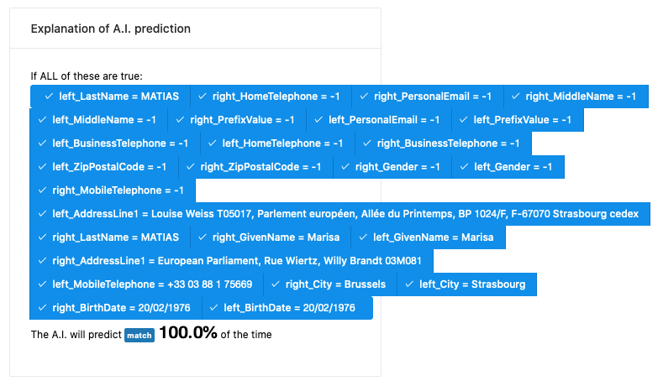
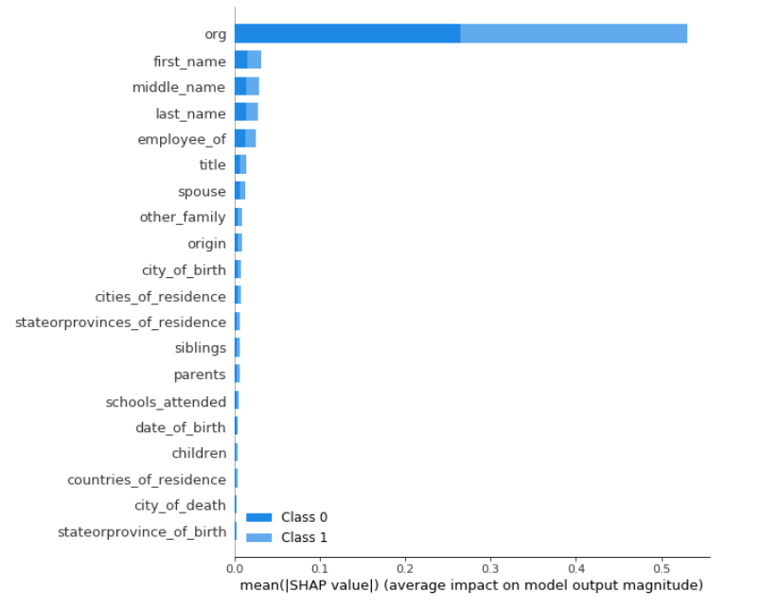
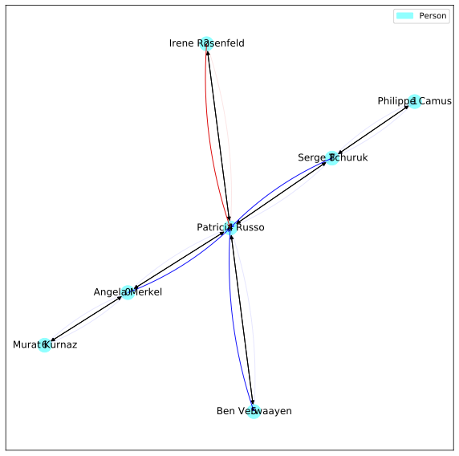
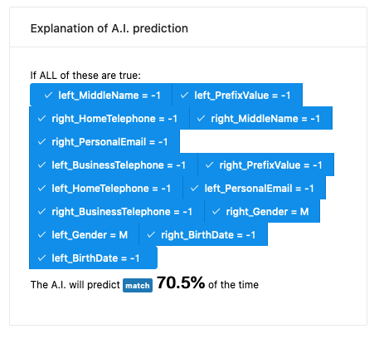
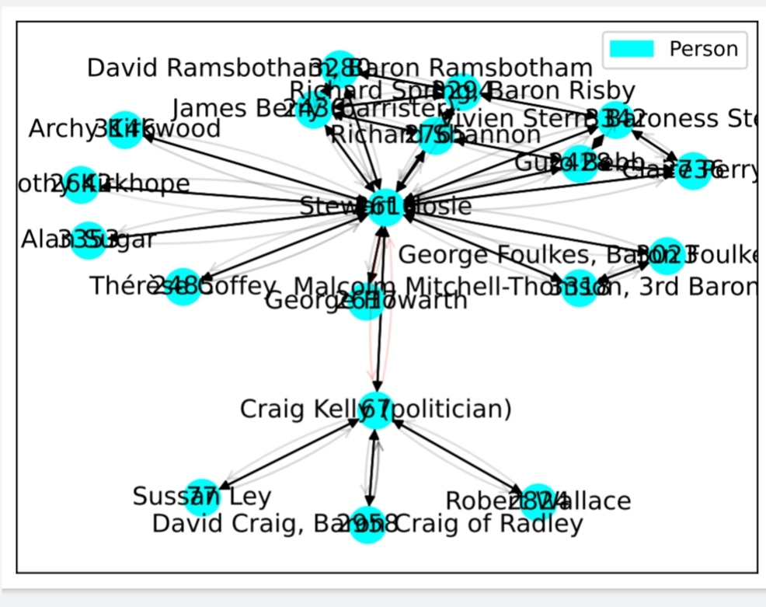
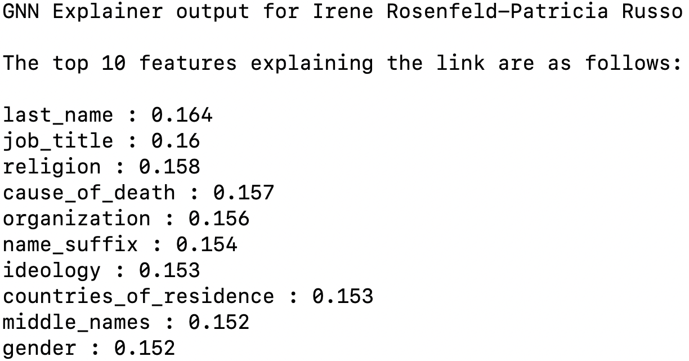
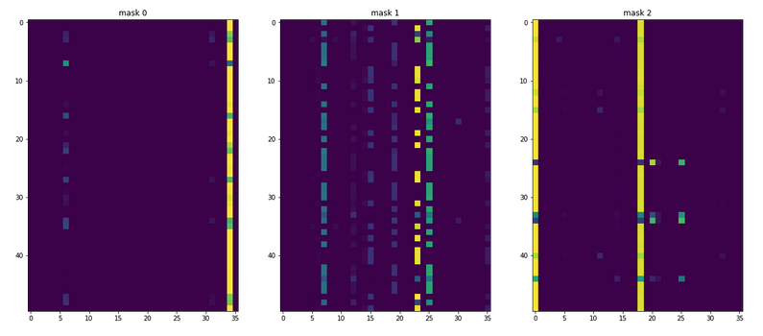
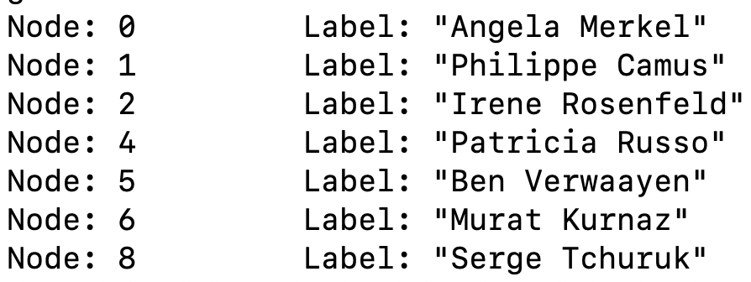
ICML 2021 Workshop on Theoretic Foundation, Criticism, and Application Trend of Explainable AI Reimagining GNN Explanations with ideas from Tabular Data
Anjali Singh¹, Shamanth R Nayak K¹, Balaji Ganesan²
¹Manipal Institute Of Technology, ²IBM Research, India
Abstract
Feature Importance From Global Methods
Sliding Window Explanations
Logical Explanation
Learning feature importance from the entire training data, referred to as global methods, can help GNN explainability.
A sliding window where we produce explanations at different levels of model accuracy could be useful.
Graph visualization has its uses, but a logical explanation might be more intuitive.
Finding feature importance by looking at all the training data is typical of models trained on tabular data
SHAP and TabNet generate such feature importance.
Anchors output at 100% accuracy
Anchors explanation displays the input, the prediction and an explanation for a given accuracy rate. They’re more intuitive than graphs in certain cases. Perhaps both the graph visualization and logical explanation could be used together.
Anchors output at 70% accuracy
GNN Explanations
A typical explanation subgraph from GNN Explainer (Ying et al., 2019) looks as shown below. These are hard to understand.
SHAP output
Figures above illustrate the explanation for the model at 100% and 70.5% accuracy.
Predictions at greater accuracy are noisier
Explanations like these are much easier to comprehend and the ability to view explanations at different accuracy levels could be useful in GNN explanations.
TabNet output
A reimagined GNN Explainer Output
GNN Explainer Output

